Slide 1
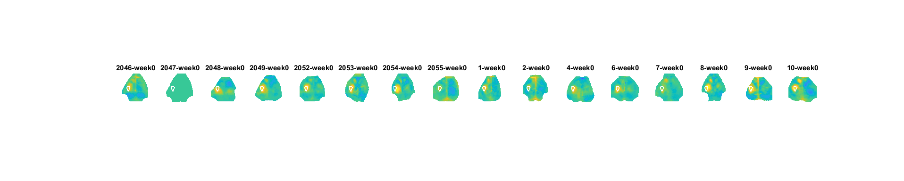
Week 0 Stim YOUNG Run 1

Slide 2
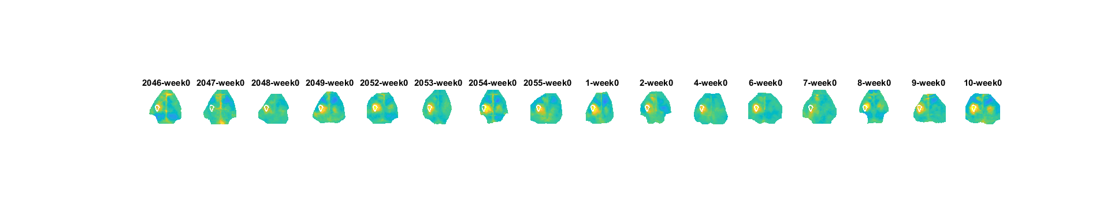
Week 0 Stim YOUNG Run 2

Slide 3
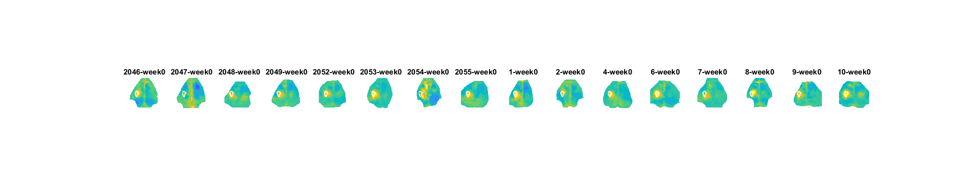
Week 0 Stim YOUNG Run 3

Slide 4
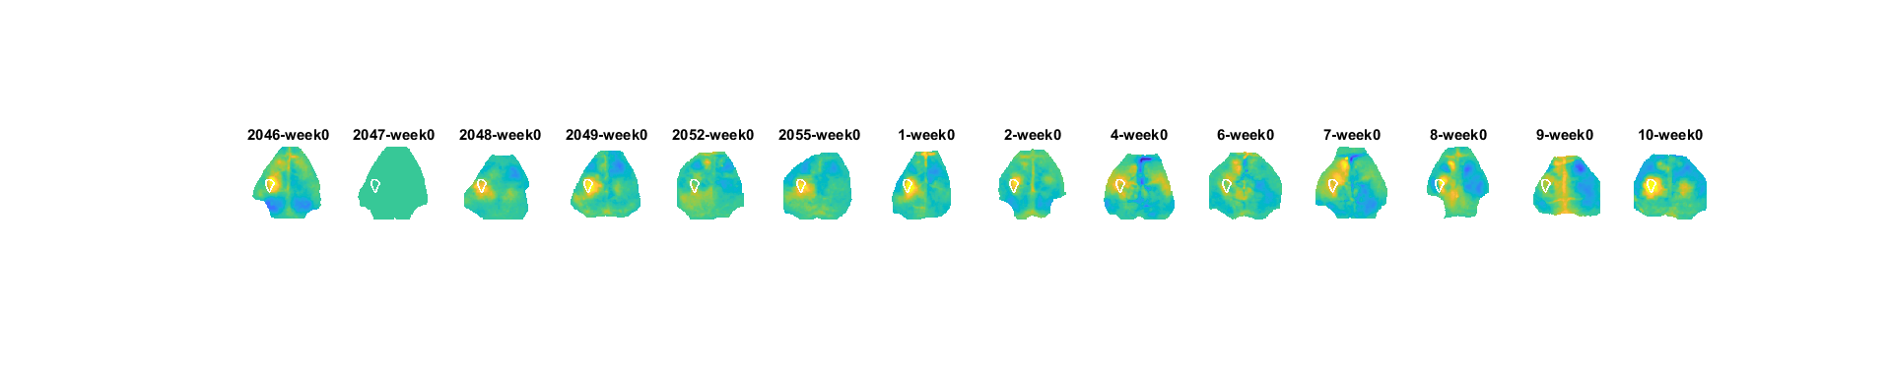
Week 0 Stim YOUNG Run 4

Slide 5
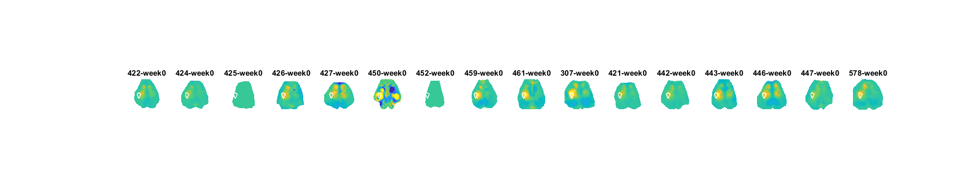
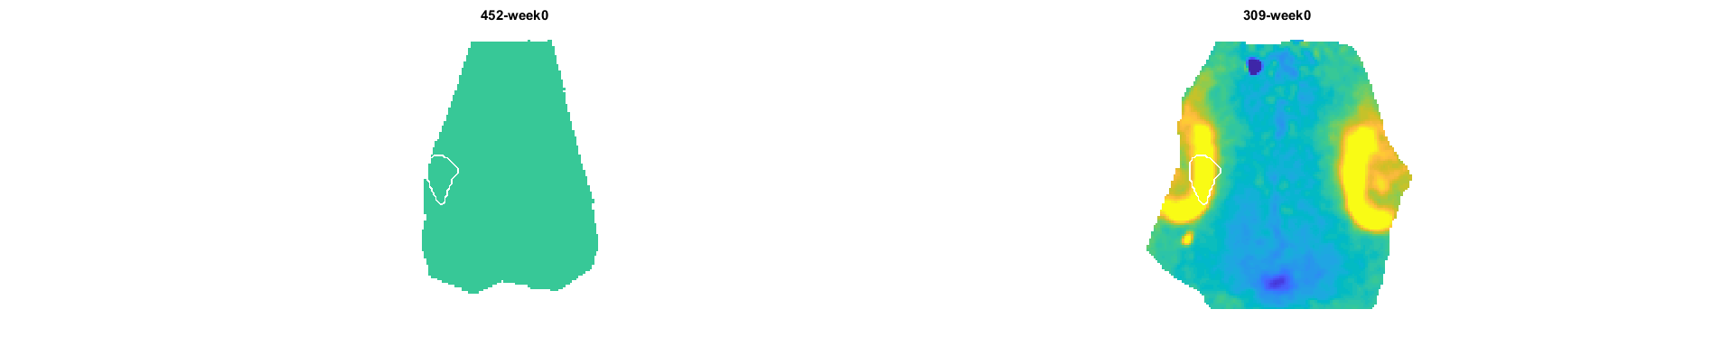
Week 0 Stim Aged Run 1

Slide 6
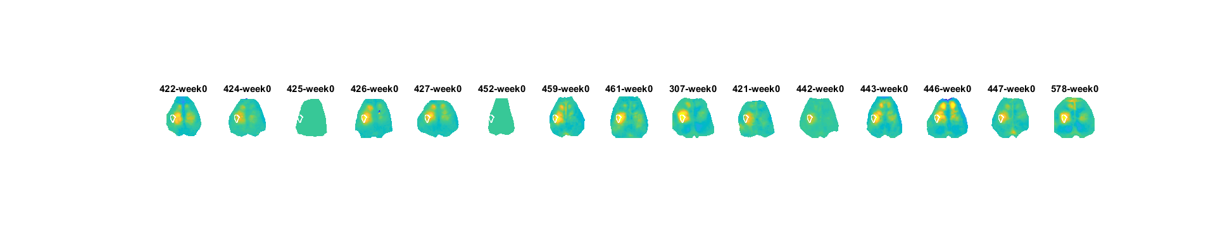

Week 0 Stim Aged Run 2

Slide 7
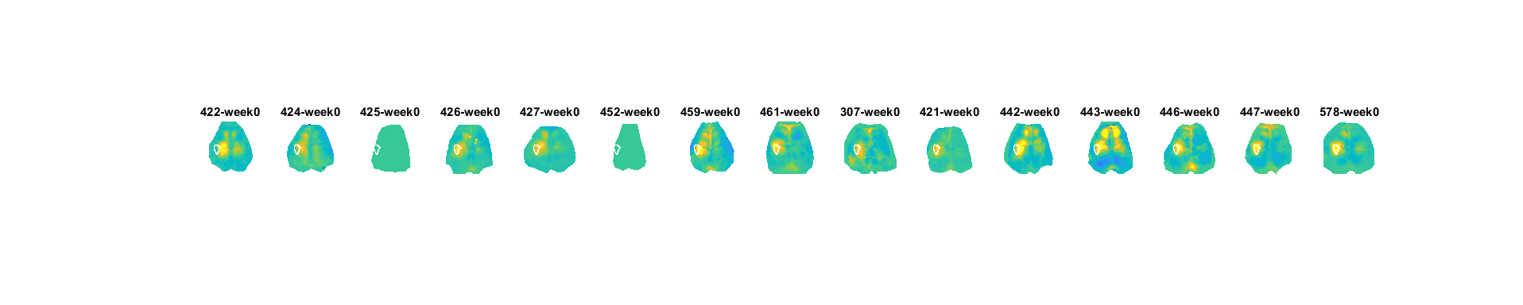
Week 0 Stim Aged Run 3

Slide 8
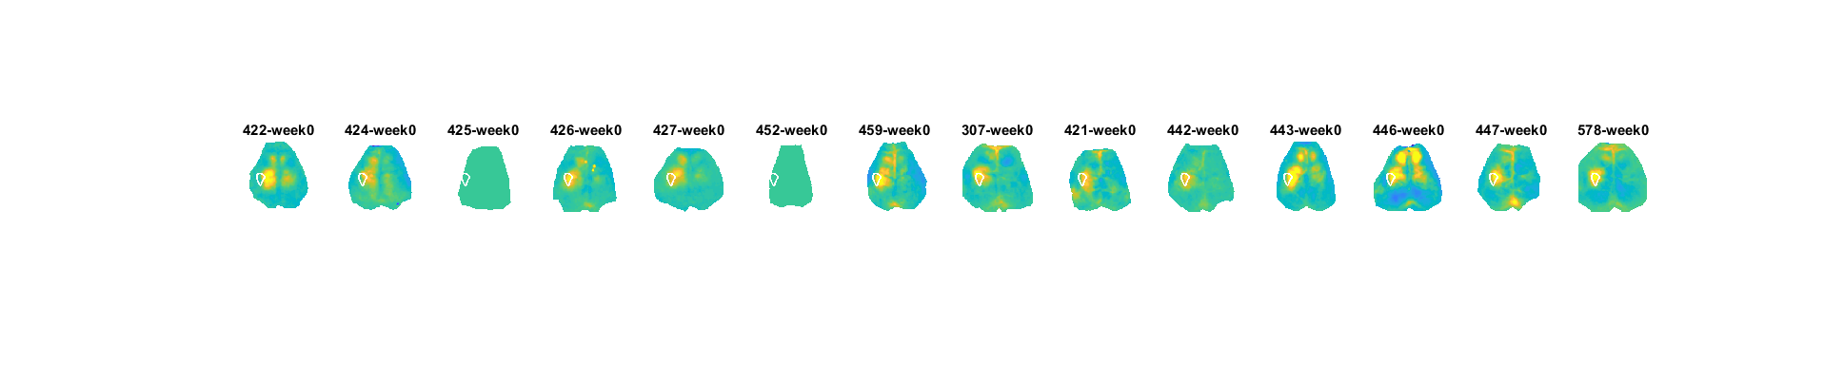

Week 0 Stim Aged Run 4

Slide 9
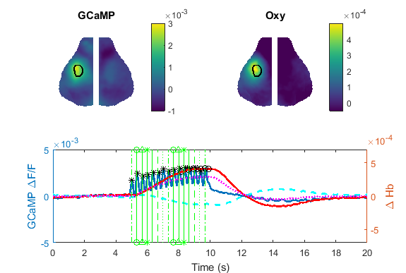
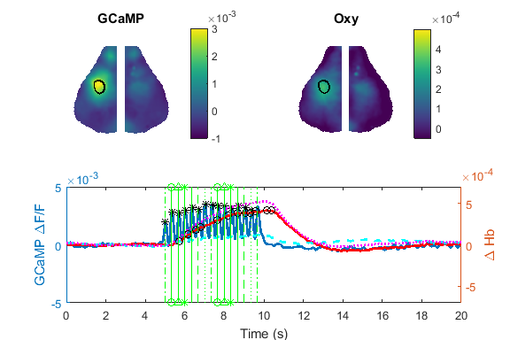
Stim Averaged Data Young and Old
Young
Aged

